Slide 1
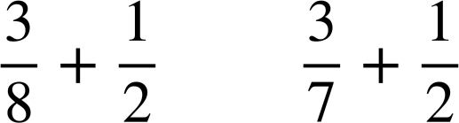
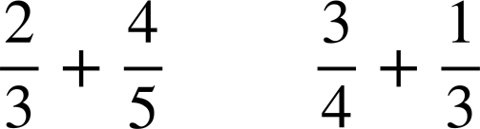
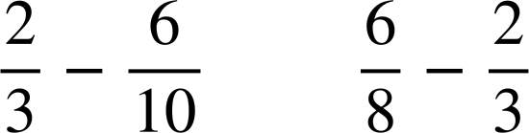




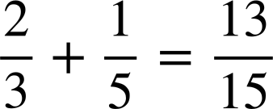
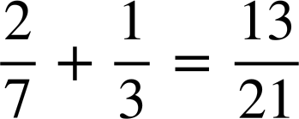
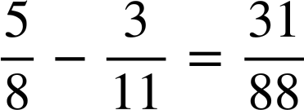
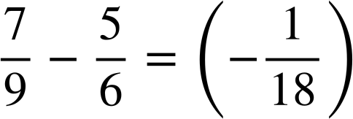
Checking understanding of addition and subtraction with fractions
Task A: Checking understanding of addition and subtraction
1) Place the symbols < or > into the following. Try to only work out the exact answer if it is not obvious.
a)
b)
c)
2) Find the missing value in each diagram. Give your answer in its simplest form.
?
d)
?
a)
?
?
b)
e)
?
?
c)
f)
3) Find the missing digits.
a)
c)
b)
d)

Slide 2
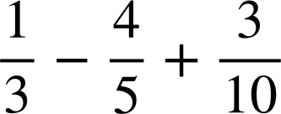
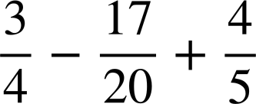
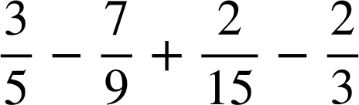
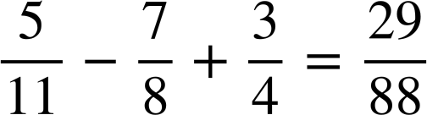
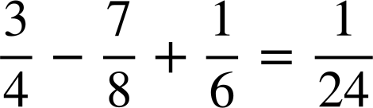

Checking understanding of addition and subtraction with fractions
Task B: Further understanding of addition and subtraction
Calculate the answers to the following:
a)
b)
c)
2) Find the missing digits in the following:
a)
b)
c)
Mathematics in Education and Industry
v2.1

